Slide 1



AGRO-X
Cultivating Life, Saving Animals

Slide 2
AGRO-X
Cultivating Life, Saving Animals

Slide 3


PROBLEM
21%
Incursion of Wild Animals into the rural landscapes, plantations, and agricultural areas Agricultural damage inflicted by insects and pests on farms and estates
Productivity Loss
Total Deaths
2018-19
55%
2300
500
ELEPHANT
WILD BOAR
People
Animals
Crop Loss

Slide 4






SOLUTION
Deterring System
Surveillance
Detection
High Beam Flickering Lights
Acoustic Frequency
Receiver
Wireless Transmitter

Slide 5
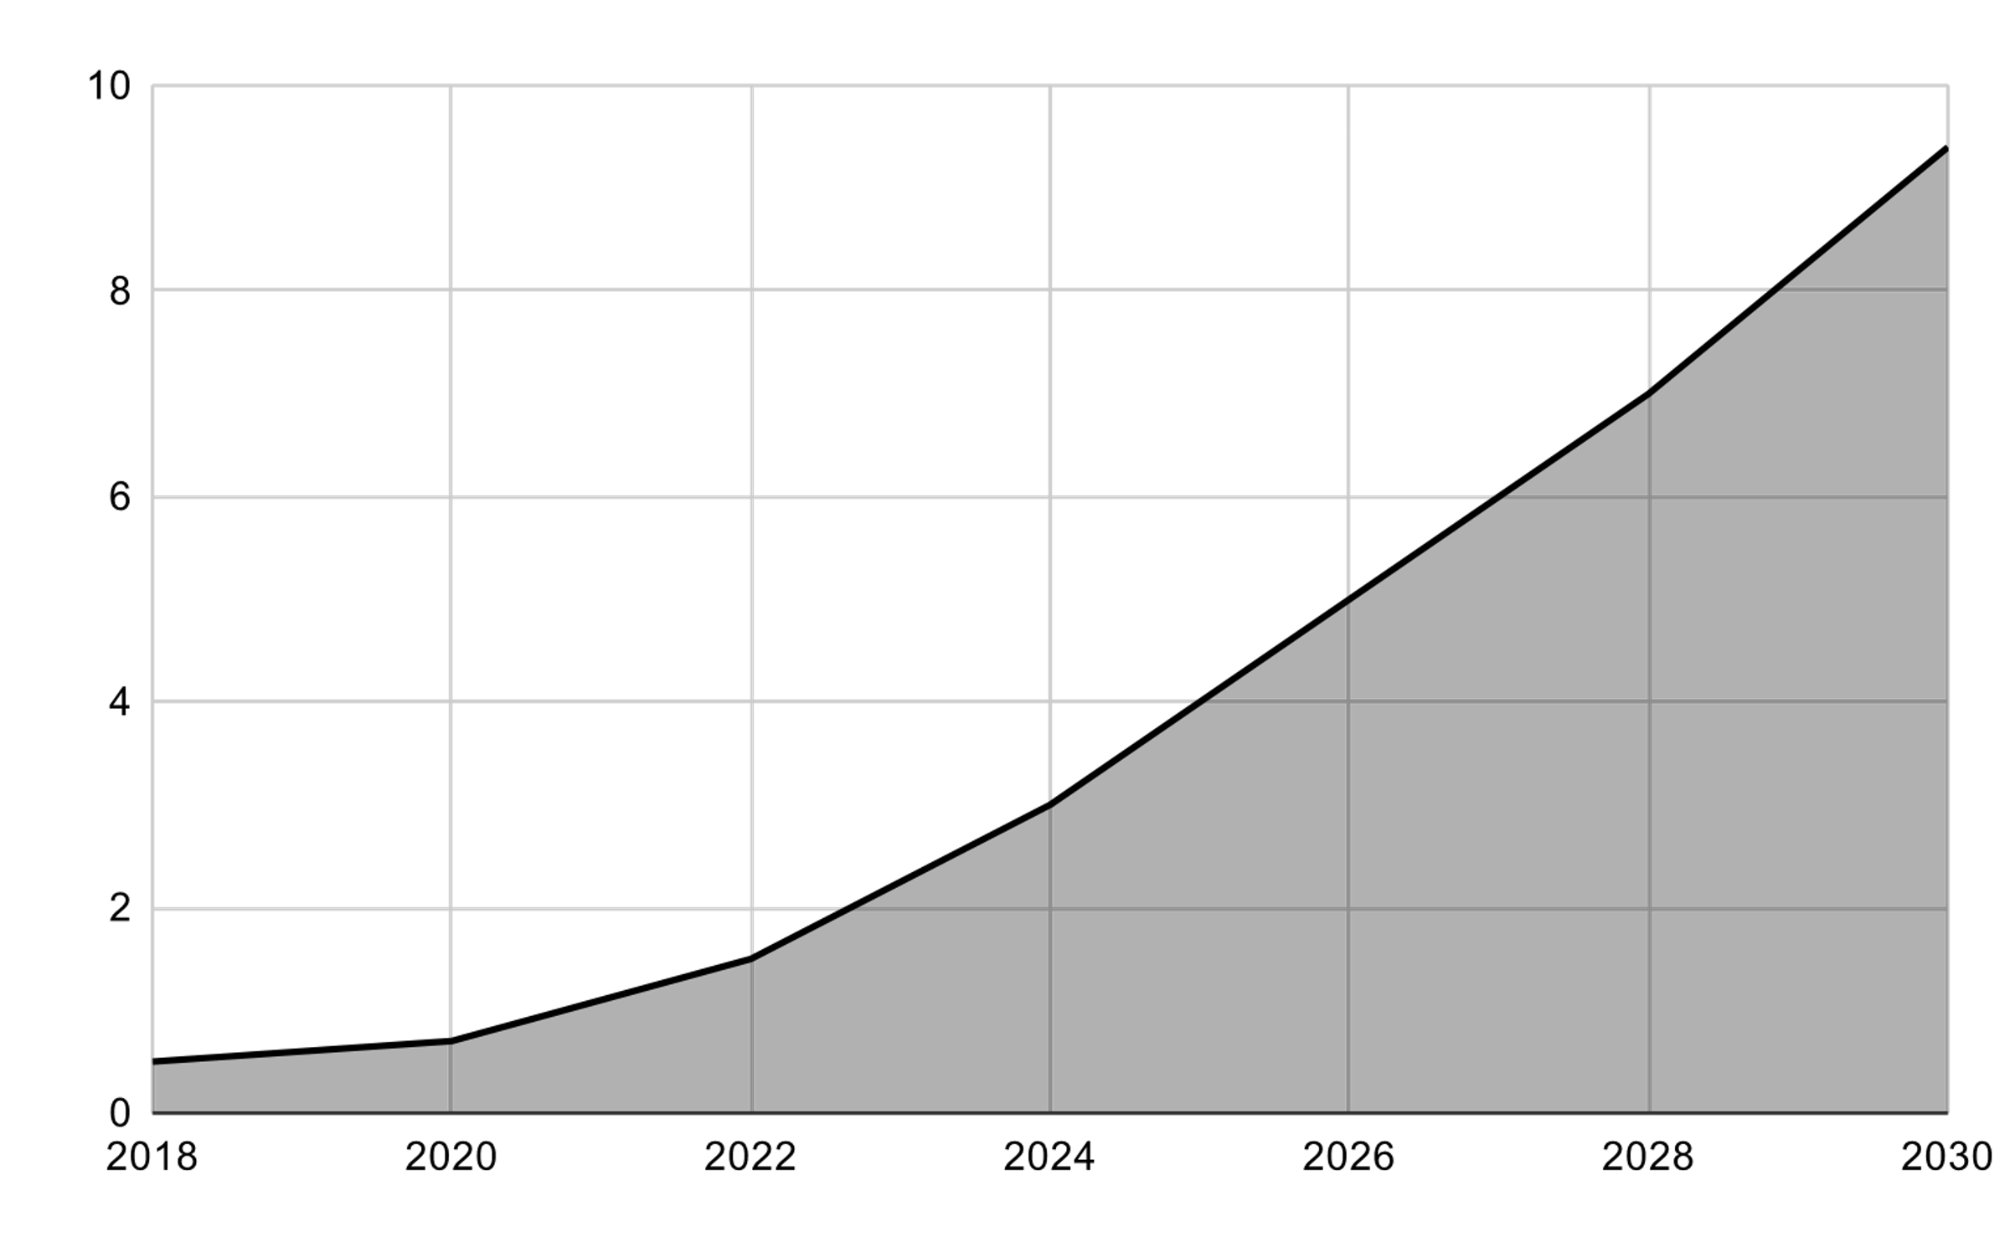

MARKET (2023)
372,940,000,000
CAGR
4.90%
From 2024 to 2029
Agriculture market in India (2024)
$473.7 billion
5000 cr
Expected revenue for 2029
Loss by animal inv.
Productivity Loss
18-25% overall
Primary livelihood
58.00 % pop.
India Agriculture market (2022-2029) USD Billion

Slide 6













BUSINESS MODEL
$609 M
WHY AGRO-X ONLY (USP) ?
CUSTOMER
SEGMENT
TAM
100%
Existing Indian market
$60.9 M
AGRO-X
Electric Fencing
SAM
10%
Target few location
Effectiveness
$ 3.04M
Firecrackers
Normal Fencing
SOM
5%
FARMERS
Our Milestone-1
Cost per Acre
RISK FACTOR
COMPETITORS
SUCCESS FACT.
AGRO-X
PRODUCT
Coverage
Replicating
Katidhan

Slide 7










GO TO STRATEGY
AGRO-X
WHAT IF ?
LOSS ANALYSIS FOR 20 MTR
1 Acre
Land
Coffee Plantation | 8,000 INR
Rice / wheat crop | 10,000 INR
15,000 INR
Per Acre
250 Mtrs
UNIT ECONOMICS
REVENUE CHANNEL
MARKETING STRATEGY
Margin
Direct to Customer
Pricing
Positioning
35%
COGS
10%
Market
“Farmer’s New Friend”
5%
R&D
Govt. Subsidies
HR & Prof.
20%
30%
WORD
OF MOUTH
VALUE PROP.
USP

Slide 8






Thanks!
PITCHED BY:
AGRO-X
Cultivating Life, Saving Animals
DHANUSH S
KAVER S A
ECE DEPT VVCE
ECE DEPT VVCE
@dhanushscience
@Kaver Devaiah
contactdhanush@proton.me
kaverdevaiah@gmail.com

